Slide 1

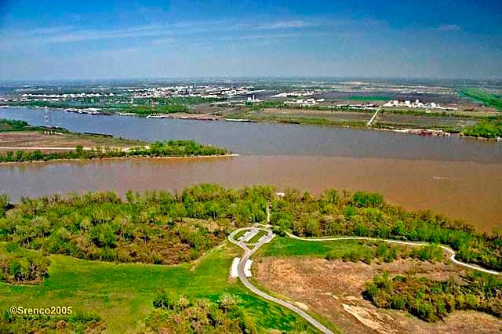
Network Algorithmics: Making the Internet Faster
George Varghese,
UCLA
Notes:
I had planned about making the Internet faster but a funny thing happened on the way to SIGCOMM. I began to think more and more about interdisciplinary thinking in a frame of reference I call confluence. So while I will talk about network algorithms, the subtitle of this talk (and more than half of the talk) is The Confluence Lens.

Slide 2
Algorithmics to speed abstractions in all systems (not just networks)
Example 1: Virtual Memory:
Abstraction: Illusion of infinite memory
Algorithmics: Paging Algorithms
Example 2: Relational Databases
Abstraction: Operations on Logical tables
Algorithmics: Query Planning
Notes:
So what’s the connection to algorithmics. I use Algorithmics in a slightly unnatural way that applies to speeding up any goof abstraction in computer science that is in danger of being abandonded because of its performance. An abstraction is an idealization of reality that allow s the programmer or user of the abstraction to be more productive by simplifying or idealizing some aspects of the underling reality. Great abstractions make life user for users of the abstraction, For example, the abstraction of virtual memory made it easy for programmers to write programs without worrying about managing storage but it required some effort in paging algorithms before this abstraction was accepted. Similarly, relational databases was an advance over CODASYL for database programmers but it took years of work in good query planning before this abstraction became commonplace.

Slide 3
How did algorithmics start
Context: Web exploding, traffic doubling, address doubling in 1990s
Problem: TCP (connected queues) and IP (datagram) slow, as were routers & servers
Network Algorithmics: techniques to restore speed of abstractions to that of fiber.
This lecture: trying to give you a sense of what this field is/was about
Notes:
When I began academic life at Wash U in the 1990s, the web was exploding, Internet traffic was doubling each year, and so were allocated IP addresses . The problem was that the beautiful networking abstractions were slow much slower than the raw fiber which was reaching 1 Gbps Folks were proposing transports like XCP for TCO and MPLS over IP to fix the performance problem. So for the purposes of this talk, I would like to think of network algorithmics as . . . And this talk then , at the least the first part, is a revisionist . . ..

Slide 4
Outline
Confluences as a way of thinking of inter-disciplinary research.
Network Algorithmics viewed as confluences from lookups to logging
Ideas for creating yourself
Notes:
I’d like to start by defining what I mean by a confluence using 3 identifying factors, then move on to surveying network algorithmics from this lens. Then I want to segue into a broader discussion if using confluence thinking in research.

Slide 5
What is a Confluence?
Notes:
To begin with the definition

Slide 6
CONFLUENCE: Where Two Rivers meet
MISSISSIPPI
MISSOURI
Notes:
Let’s s t art with the dictionary meaning. Of course, its just the meeting place of two rivers, say the Missouri and the Missisipi near St. Louis or the confluence of the Ganga and Yamnuna which Indians call Sangam

Slide 7
Confluence Definition
Inflection Point
MAIN STREAM
NEW STREAM
IMPACTING STREAM
Milieu
Change
Transformed Ideas
Notes:
For the purposes of this talk, a confluence broadly is a meeting place of two streams of thought. But I would like to add some teeth to this definition. First, I distinguish the top stream as the main stream of thought and the bottom as the impacting stream. Second, I ask for 3 specific distinctives of what I call a confluence. First, an inflection point, something happening in the world that makes the merger of the streams a good idea. Second, I ask that the new stream has a different environment from its constituent streams, what I call a milieu change, so one gets to rethink ideas in the new stream. Third, to ensure that the new stream is a true mixing of streams, I ask for evidence of one idea that transforms from the impacting stream to the new stream. Mere reuse of existing ideas would be using the impacting stream as a technology; a good thing certainlty, but not as exciting to me as true confluence of ideas. Let me hasten to make these ideas concrete by an example outside computer science

Slide 8


Example 1: Impressionism
Photography
Realistic Painting
Impressionism
Psychology
Ideas to Canvas
Thin to thick strokes
Notes:
When my friend Sriram saw this slide, he said “so this is the kind of pompous stuff you can get away with when you win an award”. I assure you I will get to networking but I want to give the definition of a confluence a workout. Let me start then in the late 1800s when the mainstream of painting can be said to have been impacted by the emerging field of psychology to form new streams of painting such as impressionism and later expressionism. The inflection point was the arrival of cheap photography which made painters question the value of merely realistic painting. At the same time, Alfred Adler has been making the distinction between the subjective and the objective. Why not, painters such as Monet reasoned, paint the subjectibe response to a landscape, am impression, which a camera cannot do. There was a mlieu change because these impressions rather than being discussed on paper in psychology would now be incarnated in paint. There were also transformed ideas as thin precise brush strokes that delineated borders gave way to blurry thick strokes that mixed in the eye at a certain distance as in the tulips om the right.

Slide 9
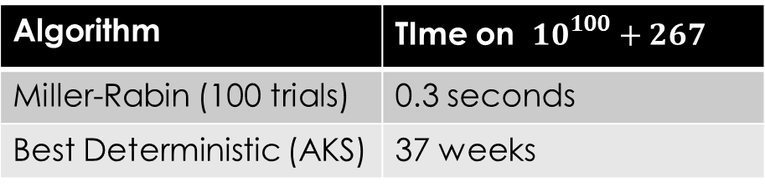
Example 2: Randomized Algorithms
Crypto
Algorithms
R. Algorithms
Probability
Always to sometimes
Sieve of Eratosthenes to Miller-Rabin
Algorithm | TIme on ${10}^{100}+267$
Miller-Rabin (100 trials) | 0.3 seconds
Best Deterministic (AKS) | 37 weeks
Notes:
Lets remember Sriram and move on quickly to an example in Computer Science. The field of randomized alhgorithms dates back to Ulam’s work on Monte Carlo algorithms but it can be said that it received a major boost from the arrival of cryptography and the need for large primes. The mlieu change was that instead of algorithms being always correct they now could be sometimes wrong. A major example of a transformed idea is how brute force testing for all factors transforms into the Miller Rabin randomized test. Even today, on a very large number Miller Rabin takes less than a second while the best deterministic algorithm known takes 37 weeks

Slide 10
More Computer Science examples
Distributed Algorithms
Streams: Algorithms, Networks
Inflection Point: Popularity of Internet
Mileu Change: Asynchrony, partial failure
Computational Economics
Streams: Economics, Computer Science
Inflection Point: Internet Auctions
Milieu Change: Large scale, small latency
Notes:
Two more computer science examples. Distrubuted algorithms can be thought of as the merger of the main stream of algorithms with the impacting stream of networks, galvanized by the popularity of the Internet. The mlieu change includes asynchrony and failure, and a simple example of a transformed idea is the Gallager Humblet and Spira MST Algorithm which is quite different from say Google Ad words.

Slide 11
Why Confluences?
Separate trends from fads
Provide a research theme
Balance desire for beauty and impact
Suggest a new field in making, especially when the original field has matured
Notes:
But why look at existing and new work through the lens of confluence. I will develop this thesis in the second part of the talk, but I suggest that the confluence lens allows us to separate trends from fads by looking for the inflection point and the milieu change; once identified it provides a theme for research and a spring of specific research ideas; further the inflection point makes it more likely that the resulting research will have impact, and the milieu change allows creative freedom to rethink ideas in sometimes beautiful ways, balancing the twin desires we have as computer scientists for both beauty and impact. Finally, a discerned confluence can sometimes suggest a new field in the making, a green field area, especially a boon when the original field (think TCP papers) has matured

Slide 12
All Interdisciplinary work ≠ confluence
Large network data
Networking
Network Learning?
Learning Theory
Distributed data ?
What concept has changed?
Notes:
I hope you will not dismiss the confluence lens too easily as merely interdisciplinary thinking, something we hear of all the time. According to the definition I like to use, not all interdisciplinary work is a confluence. For example, there is some learning theory that is applied in networks. Does that make “network learning” a confluence. Not to my mind. One can argue there is an inflection point in the large amount of network data and say that the mlieu change is distributed data but until key concepts lke k means and decision trees change because of distribution I would not say there was a confluence

Slide 13
Network Algorithmics via Confluences
Notes:
Nuff said. Time to get back into the fast lane after a bried detour. I’d like to take a whirlwind tour of various concepts that helped make the Internet fast but looked at retrospectively though the confluence lens

Slide 14
Network Algorithmics
Definition: A set of algorithms to make network devices (servers, routers) faster
Streams: A confluence between computer architecture, algorithms & networking
Inflection Points: cheap clusters (servers), explosion of web, IPv6 (for routers
Two examples of transformed ideas: RDMA and Binary Search on prefix lengths. Many more
Notes:
But why look at existing and new work through the lens of confluence. I will develop this thesis in the second part of the talk, but I suggest that the confluence lens allows us to separate trends from fads by looking for the inflection point and the milieu change; once identified it provides a theme for research and a spring of specific research ideas; further the inflection point makes it more likely that the resulting research will have impact, and the milieu change allows creative freedom to rethink ideas in sometimes beautiful ways, balancing the twin desires we have as computer scientists for both beauty and impact. Finally, a discerned confluence can sometimes suggest a new field in the making, a green field area, especially a boon when the original field (think TCP papers) has matured

Slide 15
1. RDMA Example (Servers)
Servers getting slow as they used remote disks. READs from disk to memory slow
Inspiration from computer architecture: DMA from disk to memory, bypass CPU
Do same thing across network (RDMA). Needs lots of new ideas
RDMA a major force in data centers of Google, Microsoft to make servers fast.
Notes:
But why look at existing and new work through the lens of confluence. I will develop this thesis in the second part of the talk, but I suggest that the confluence lens allows us to separate trends from fads by looking for the inflection point and the milieu change; once identified it provides a theme for research and a spring of specific research ideas; further the inflection point makes it more likely that the resulting research will have impact, and the milieu change allows creative freedom to rethink ideas in sometimes beautiful ways, balancing the twin desires we have as computer scientists for both beauty and impact. Finally, a discerned confluence can sometimes suggest a new field in the making, a green field area, especially a boon when the original field (think TCP papers) has matured

Slide 16

Example 1: RDMA [KSL 86]
Cheap Clusters
Networking
Algorithmics
Architecture
Machine bus to
Network bus
DMA
RDMA
Network
Net
Notes:
My first encounter with algorithmics was when I joined DEC after my Master’s and found a beautiful confluence between computer architecture and networking that led to something that today is called RDMA but was part of the VAXCLuster system invented by Strecker, Kronenberg, and Levy. The inflection point was the realization that one could create cheap clusters in this case of VAXes, and the milieu change was that instead of the somewhat simple bus in a single computer one had two computers connected by a network which you should think of as some form of Ethernet. In particular, Strecker reasoned that since Direct Memory Access was a cool way of sending large amounts of data directly from the disk to memory without bothering the CPU, the idea could be extended to Remote DMA from the memory of computer 1 to the memory of computer 2 without thei intervention of either CPU. Data was copied only once over the bus and the overhead of systems calls and interrupts was minimal. Of course, today RDMA is a major force in storage networks but people forget it was invented in 1986.

Slide 17
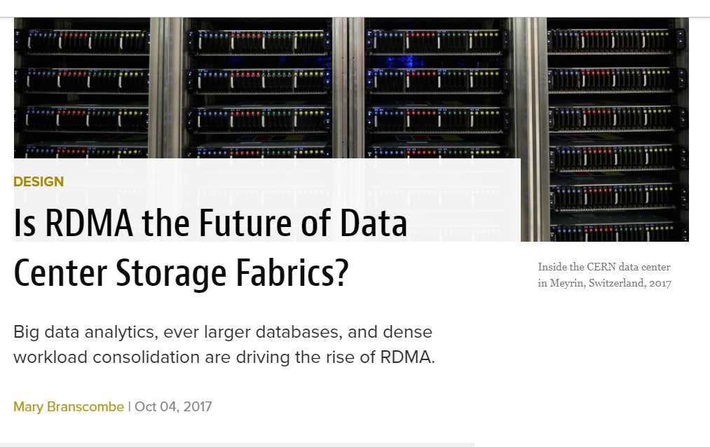

https://www.datacenterknowledge.com/design/rdma-future-data-center-storage-fabrics

Slide 18
From RDMA to Fast Servers: Other transformed ideas
Inflection point: Internet heating up (90s)
Fast Buffers: Avoid packet copies without changing protocol → 0 copy interfaces
Application Device Channels → Bypass OS and go direct from App to Network
Header Prediction → Predict that next packet will be in order to make common case of TCP processing fast
Notes:
Soon after VAXClusters, a new inflection point arose as the Internet began to heat up. Servers were found to be woefully slow because they copied data across layers and because of system call overhead. While RDMA did avoid these overheads, it required protovcol changes and only worked for large data transfers. Thus began a stream of work in SIGCOMM influenced by the OS community which tried to retaining structure and protection, and get the same effect without protocol changes by local Operating System changes,. I pick three representative ones, FBUFS from Druschel and Peterson which showed how it was possible to avoid copies while Application Device Channels from Druschel, Peterson and Davy which showed how to avoid system calls . Both ideas are alive and well in what people call Zero Copy Interfaces and VIA. Messages was roughly concurrent with Application Level Device Channels that again avoided control overhead by local changes (bypassing system calls). Today even trade rags refer to Zero Copy interfaces, and no system calls via something called VIA. With VJ header prediction showing that one could get fast TCP performance in the expected case, the stage had been set for fast servers.

Slide 19
2. Prefix Lookup (Routers)
Your Facebook feed is a set of Internet messages carrying a 32 bit IP address
Routers send your message onwards by looking up a forwarding table
To avoid a table of a billion addresses in each router, routers store prefixes
This reduces router memory but routers now have to solve longest prefix match for every packet billions of times per second! Even harder for IPv6 with 128 bit addresses. How to cope?
Notes:
But why look at existing and new work through the lens of confluence. I will develop this thesis in the second part of the talk, but I suggest that the confluence lens allows us to separate trends from fads by looking for the inflection point and the milieu change; once identified it provides a theme for research and a spring of specific research ideas; further the inflection point makes it more likely that the resulting research will have impact, and the milieu change allows creative freedom to rethink ideas in sometimes beautiful ways, balancing the twin desires we have as computer scientists for both beauty and impact. Finally, a discerned confluence can sometimes suggest a new field in the making, a green field area, especially a boon when the original field (think TCP papers) has matured

Slide 20
Prefix Lookup Details
A prefix is the start bits common to lots of computers in an organization like UCLA
Core routers don’t store all addresses in UCLA: just a few prefixes (see kb.ucla.edu)
One UCLA prefix: 128.97.0.0/16
Write each number between dots in binary and take first 16 bits →
10000000 01100001 *, where * is don’t care
Notes:
But why look at existing and new work through the lens of confluence. I will develop this thesis in the second part of the talk, but I suggest that the confluence lens allows us to separate trends from fads by looking for the inflection point and the milieu change; once identified it provides a theme for research and a spring of specific research ideas; further the inflection point makes it more likely that the resulting research will have impact, and the milieu change allows creative freedom to rethink ideas in sometimes beautiful ways, balancing the twin desires we have as computer scientists for both beauty and impact. Finally, a discerned confluence can sometimes suggest a new field in the making, a green field area, especially a boon when the original field (think TCP papers) has matured

Slide 21
Example 2: IP Lookup [WVTP 97]
Traffic, IP v6
Networking
Algorithmics
Algorithms
Msec to usec
Binary Search
On Lengths
P
Prefix 1
Length 0
Length 32
Prefix N
O (log N)
O (log W)
Notes:
The first glimmer of a real confluence between algorithms and network that I encountered arrived because of a new inflection point. IPv6 was rumored to be imminent and addresses were now 128 bits. Simple trie like schemes were roughly linear in the number of bits which was too slow. Of course, theory had some fast algorithms but they were mostly O(log N) schemes where N is the number of prefixes and the mileu was different. While most theoretical algorithms were content with working in msec, an arriving packet had less than a microsecond to be forwarded. It was puzzling over IPv6 that we discovered a prefix lookup scheme that took O(log W) memory accesses, which for IP v6 was 7 memory accesses. This to me seemed to be a transformed concept. While O(log log N) algorithms were known for lookups due to Van emde Boas they were for exact lookups and a lot more complicated.

Slide 22
Binary Search on prefix lengths: how a collision with an outsider Jon Turner (JST) led to a new algorithm
Length 1
Length 2
Length 3
1*
10
101*
Day 1: JST, For binary search start in middle
Day 3, GV, Bug, precompute answer of marker
Day 2: JST, Doesn’t work, Oh, just add markers
Notes:
The story of Binary Search on prefix lengths is a classic tale of an encounter with an outsider. I met Jon Turner on the stairs of Bryan Hall in Wash U and he asked me why one couldn’t do binary search on prefix lengths. Prefixes would first be segregated by their length and then at each length a search for a prefix required only an exact match by hashing. The normal way would be to start with the longest length and work back, but Jon wanted to start in the middle length and do binary search. I thought about for a few minutes and showed him a simple example with two prefixes and asked him how one could search in the middle length when there was nothing there. Some days later, he met me on the same stairs and told me “that’s easy”. For every longer length prefix add an artificial prefix we called a marker at all lengths where binary search would reach. This was great but I realized there was a bug. Sometimes markers would take you on a wild goose chase to the second half (for example10 takes you to the second half for 100 when the answer lurks in the first half. Fortunately, rather than tell him about it I decided to fix it myself, my main value add, by precomputing the best matching prefix of every marker. For example, 10 ‘s best matching prefix is 1* and so if you remember the best match of every marker, when you fail that becomes your answer without the need for backtracking. Amazingly, on a bus a few days later, I sat next to this really smart Swiss student marcel who was visiting Wash U. He had all the same idea as Jon and the same bug. So we began working together and of course Marcel did all the implementation and added a lot of cool ideas of his own as well.

Slide 23
Algorithm Summary
Arrange prefixes by lengths. Start in middle length table. If you get a match go to right half else go to left half
To make it work, have to add dummy prefixes as markers. A 32 bit prefix leaves markers in the Length 16 table, length 24, length 28 table etc.
Markers can cause us to go on a wild goose chase to right half when answer is in left, So we precompute longest match of every marker and remember that when we go to right.
Bottom Line: only log (128) = 7 accesses to tables even for 128 bit 1P addresses. Not classical binary search
Notes:
But why look at existing and new work through the lens of confluence. I will develop this thesis in the second part of the talk, but I suggest that the confluence lens allows us to separate trends from fads by looking for the inflection point and the milieu change; once identified it provides a theme for research and a spring of specific research ideas; further the inflection point makes it more likely that the resulting research will have impact, and the milieu change allows creative freedom to rethink ideas in sometimes beautiful ways, balancing the twin desires we have as computer scientists for both beauty and impact. Finally, a discerned confluence can sometimes suggest a new field in the making, a green field area, especially a boon when the original field (think TCP papers) has matured

Slide 24
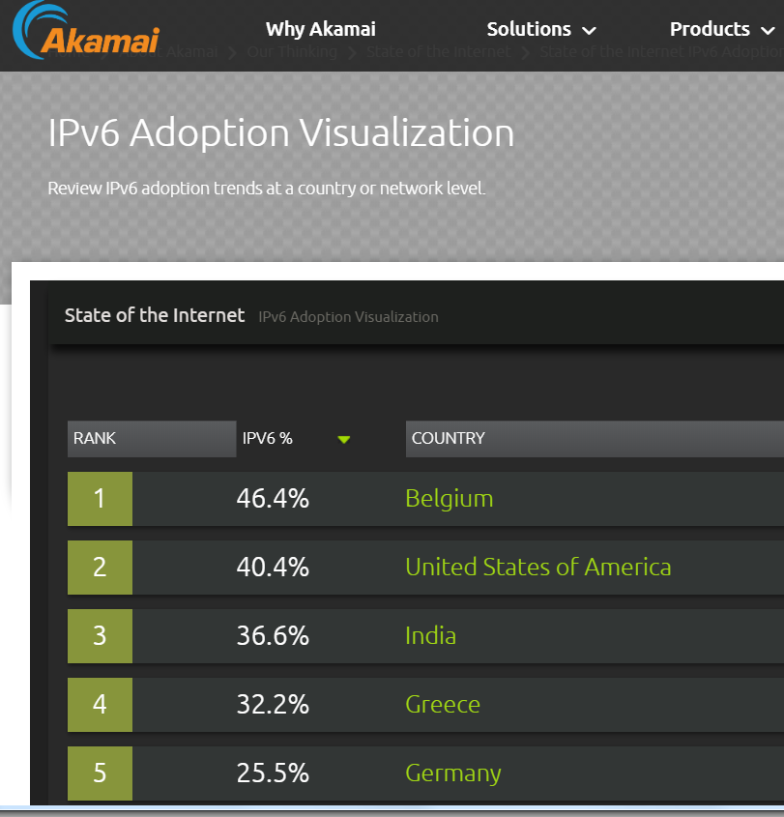
https://www.akamai.com/us/en/about/our-thinking/state-of-the-internet-report/state-of-the-internet-ipv6-adoption-visualization.jsp

Slide 25
Fast Routers common by 2000s
Cisco Cat 6K, GSR, Juniper M40
All the problems (switching, lookups, ACLs, scheduling) had reasonable hardware
Solutions scaled as link speeds scaled
New Algorithmics problems after 2000 in measurement & security (e.g., catching worm attacks) & flexible routers (P4)
Notes:
Between algorithmics for fast switching, IP Lookups, and packet scheduling, there was generally a sense by the 2000s that people knew how to build fast routers. There was the Cisco 6K, the first router with a crossbar, the Juniper M40 the first router that used ASICs for forwarding, and the Cisco GSR., Better still the solutions folks used scaled as link speeds scaled. Silicon Valley had figured out routers. Was there nothing left for router Algorithmics?

Slide 26
Create yourself
Notes:
II want to take a deep breath and contemplate the Missouri and Missippi once again, and now take on a reflective note. If you are a young researcher, how can confluence thinking help you? I would like to generalize a little from my past experience to offer 6 suggestions.

Slide 27
What should CS at UCLA give you?
You will certainly learn to code in CS 31. 32. You will learn algorithms
Just these will get you a job at Google or Facebook if you study for the interview
You will also learn about internals (OS, networks, architecture, databases)
But as part of an amazing UCLA freshman batch, I hope you will learn to create something new, an idea or a product. How?
Notes:
But why look at existing and new work through the lens of confluence. I will develop this thesis in the second part of the talk, but I suggest that the confluence lens allows us to separate trends from fads by looking for the inflection point and the milieu change; once identified it provides a theme for research and a spring of specific research ideas; further the inflection point makes it more likely that the resulting research will have impact, and the milieu change allows creative freedom to rethink ideas in sometimes beautiful ways, balancing the twin desires we have as computer scientists for both beauty and impact. Finally, a discerned confluence can sometimes suggest a new field in the making, a green field area, especially a boon when the original field (think TCP papers) has matured

Slide 28
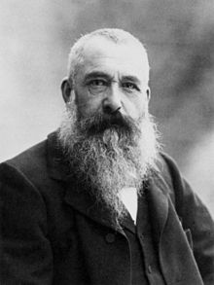
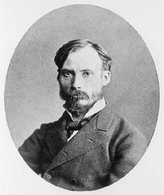
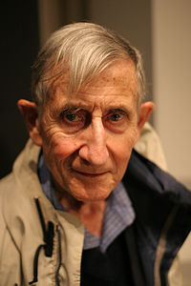
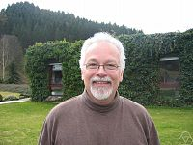
1. Embrace Collisions with people with new perspectives
Impressionism
Paris
1860
Monet
Renoir
Confluence:
Number Theory
with Physics
Princeton
1973
Dyson
Montgomery
Miller
Randomized
Algorithms
Rabin
MIT, 1975
Notes:
The first suggestion is to embrace collisions. I feel a large number of confluences are catalyzed by collisions between people often of different backgrounds. Impressionism caught fire because of collisions between Monet, Sisley and Renoir in a café in Paris. A very famous collision is the Princeton tea party where a mathematican called Hugh Montgomery met Freeman Dyson and told him of his work on the distribution of the zeroes of the zeta function. Dyson said it reminded him of a similar distribution in quantum mechanisms and this began an amazing confluence between Physics and number theory. Similarly, the Rabin Miller algorithm occurred because of a collision betweenb Gart Miller and Rabin at MIT in 1975

Slide 29
2. Pick your problem carefully
Watch for Trends (Top Down)
Read Trade Rags
Listen to Grapevine
Talk to others (teenagers, kids)
Know your Strengths (Bottom up)
Collaborators
Personal skill set
Access to Data (secret weapons)
Notes:
A second question some students asked me was “All this talk about confluences is great. But how do you pick a confluence. First is to watch for trends. I recommend reading Trade Rags like BYTE and NETWORK WORLD as much as you read the SIGCOMM Provceedings. Things like worms and Span were well known in such rags long before they became popular in SIGCOMM. As Don Towsley says, listen to thegrapevine. Finally, talk to outsider. Dave Clark was fond of saying every network person should talk to an economist. I have personally found it more helpful to talk to teenagers. My sons have clued me in on so many phenomena that kids are using. The Second is to know your own strengths. I could not hope to work on computatinal photography though I believe it is an interesting confluence. When I joined MSR I decided to move out of genomics. At UCSD, I had collaborators like Vineet and data from the UCSD Medical School. When I came to MSR, they were absent.

Slide 30

3. Keep thinking via an Idle Loop of Old Important Problems
Keep thinking of older problems in background as one learns new techniques
Synchronize routers after partition heals
→ Set Difference algorithm 10 years later
Bridge Learning via sending SYSIDs
→ Carousel solution 10 years later

Slide 31

4. Be contrarian in picking problems
Examples I have worked on:
Industry felt route lookups too slow
Fast IP Lookups common today
Academics felt packets had to be sorted by deadlines to be fair across conversations
Cheap modification of Round Robin works (DRR)
Humans must produce attack signatures
Automated signature extraction.
Notes:
Confluence thinking is about a broad approach to research where the milieu change gives opportunities for creative rethinking of solutions and the inflection point helps ensure that the time is right. But what specific problems should you pick? What has worked for me is similar to what Towsley and McKeown report: be contrarian. When the world is moving to the left, and you feel have a angle of attack, consider moving to the left.

Slide 32

But balance risk . . .
Analogy from Football: Don’t just throw long balls, run the football occasionally.
Analogy from Finance: Balance your portfolio. Buttress your stocks with bonds.
Similarly: keep at least one risky problem but add safer ideas. Have to make a living!
Confluence
Safe work

Slide 33
Conclusions
Confluences: Look for the inflection point and the new milieu before jumping in
Network Algorithmics: Not same as algorithms, different measures & models
Differences: Sometimes (RDMA) we change OS structure; in longest match we sacrifice insertion time (msec) for fast search (nsec)
Create Yourself: by embracing collisions, being contrarian, and having an idle loop

Slide 34

5. Finally, avoid extremes
Influenza, commonly known as "the flu", is an infectious disease common among mammals. The most common symptoms are chills and fever.
Confluenza, commonly known as "the conflu", is an infectious disease unique to researchers. The most common symptoms is excessive preoccupation with finding confluences in every aspect of life.
Get your conflu shot today Thank you!
Notes:
To end the talk let me remind you my model for confuences: a meeting place between two streams of thought, a main stream and an impacting stream. It requires further three things: an inflection point that makes the merger compelling, a milie change that allows new creative freedom, and finally an example of at least 1 transformed idea. I also suggested you follow 5 habits to jump start confluences: seek collisions, spot coming confluences, create coherence, be contrarian, and seek congruence in your own life, I want to end with a 6th principle which is not a C but a statutory warning. You have all heard of influenza but when I keep thinking about confluences for a long period., I feel the distinct symptoms of another disease that I looked up and lo and behold it was called . . . Confluences are, I believe, a good model but like all ,models one can take them too far and one takes to take it with a pinch of salt. So get your conflu shot today to avoid taking this to extremes. Thank you!

